Slide 1



WebGLStudio
a Pipeline for WebGL Scene Creation
Javi Agenjo, Alun Evans, Josep Blat
Universitat Pompeu Fabra
Notes:
Hi, my name is Javi Agenjo, I'm a graphics programmer researching in the GTI group inside Universitat Pompeu Fabra, from Barcelona, Spain. Our group focuses in interactive 3D graphics, 3D avatars, and high quality rendering.

Slide 2
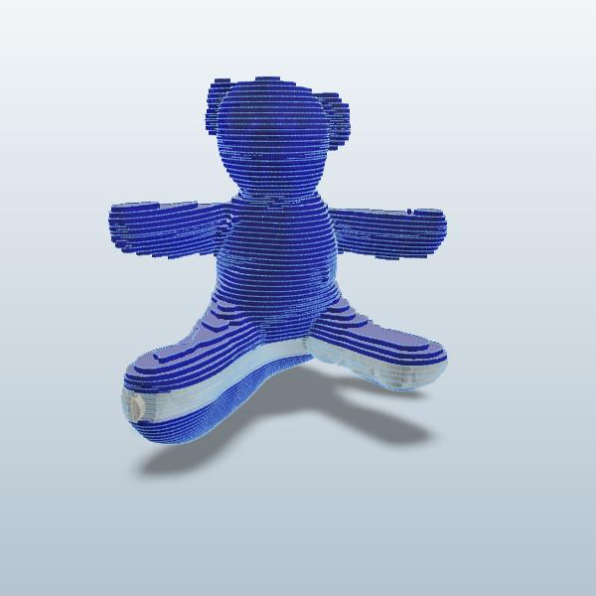
Motivations
Paradigm shifting from Desktop to browser in all lightweight daily applications
Autodesk 123D
Notes:
Over the last two years a big change has been happening in the way applications are delivered to the end user. Now all daily applications are moving to what is called "the cloud". Applications like Mail (Gmail), office suites (Google Docs), Calendars, project managment. But now a new breed is coming for more profesional intensive applications (Audio, Music, Video, Programming, 3D, ...).

Slide 3

Industry Needs
Our department was working on industry projects that required browser based 3D editors
2 years ago: Started developing a proof of concept 3D editor, meant to test the possibilities of the web for high-performance
Notes:
We have developed 3D desktop applications for the last 4 years for specific projects, but 2 years ago we were approached by companies with specific needs, where they want to integrate 3D technologies in their existing pipelines, which means they have to run anywhere and interact with other existing web technologies. So we started developing on the web.

Slide 4
What is an editor?
An environment where users can import resources, and arrange them to construct a semantic scene to share
In a 3D environment the resources are meshes, textures, materials, and other scene components (lights, cameras)
The result is an interactive 3D Scene available in any browser.
Notes:
At the beginning we werent sure if we could achieve a good quality product on the web, so we started developing our own editor with mild features (importing resources, moving them around, ...) but the developing cycles on the web are usually really fast thanks to the dynamism of Javascript, and the performance was much better than expected, so soon we had a full 3D web editor.

Slide 5

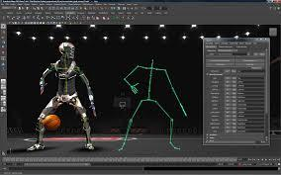
What's out there?
Realtime editors / Engines
Unity
Unreal Engine
Blender
Offline 3D Editors
Maya
3Ds Max
Cinema 4D
Notes:
This doesnt mean we think all software will be shifting to the web. Professional 3D authroing applications are still necessary due to the better performance and access to the hardware layer. But we find that there are some tools missing, and those could be developed on the web, for instance realtime editors where you can see the results of your actions instanly (instead of having to wait to an offline renderer).

Slide 6
Web 3D Engines
Unity (now very common for cross platform 3D)
Flash 3D
Unreal Engine (WebGL version as of March 2013)
Three.JS
Other WebGL Custom Engines...
VRML...
Notes:
There are some good tools for the web now, but most of them are just web-players, you export your data from a desktop applications and you can see the results on the web. They have an strong dependence on the desktop apps, and require more complex development pipelines.

Slide 7
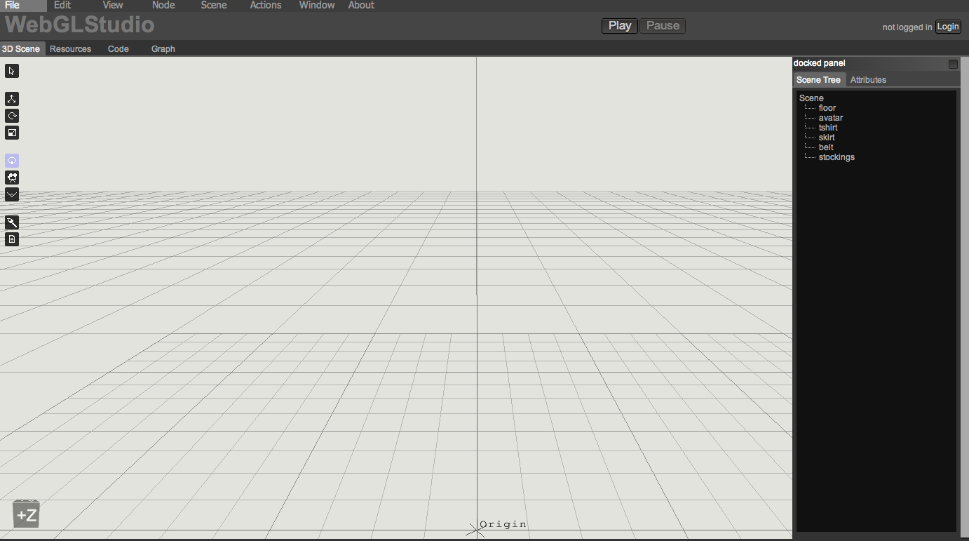
WebGLStudio overview
Core Engine
Render Pipeline
Editor
Resources Manager
Post-processing effects
Particle Engine
Realtime mesh painting
Scene saving / export
Notes:
So we present our own tool, which features some advanced options as a proof of concept that complete 3D suites can be build on the web. Our engine features a high quality rendering pipeline, resources management and some other cool features we will see now.

Slide 8
Core Engine
Lightweight low level library to wrap most of WebGL functionality, called LiteGL
Classes for basic components in 3D: Mesh, Texture, Buffer, Shader
Mathematics: uses glMatrix, adds other classes like Octree, RayTesting, AABB, ...
LiteScene library to handle the Scene Graph
Classes: Scene, SceneNode, Component.
Camera, Light, ...
ResourcesManager
Notes:
The Core Engine of the application is divided in two layers, a low level layer wrapping WebGL to make it easy to use and abstract the programmer from the ugly API calls. And a Scene Graph library with a rendering pipeline. This two layers can be used separately without the need of all the complexity of our editor, this way we can include the results of our editor in any webapp with ease.

Slide 9
Core Engine main features
SceneGraph
Component based
Resource Management
Binary formats for fast loading
Meant to high quality rendering
Works in Firefox and Chrome (not tested fully on Safari)
Notes:
From the features perspective, our Core Engine has a Scene Graph where every node on the Scene contains components that expand its functionalities, This makes it really easy to add new features to the scene, for rendering but also for interaction. It has a resource management where files can be easily stored and organized on the server. We have our own binary format to store any kind of data, improving the parsing stages during loads. We achieve a high quality rendering thanks to a complete shader solution. And it has been tested in several computer with different specs without problems.

Slide 10
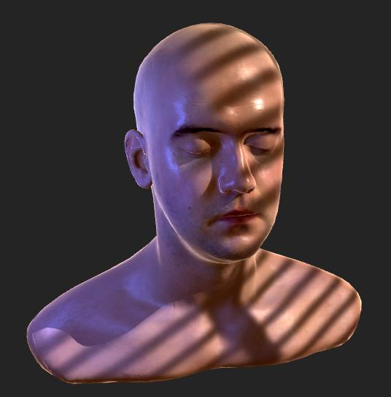
Core Engine

Slide 11
Render Pipeline
Generates the shader according to the material properties (ubershader)
Supports multiple lights (omni, spot and direct) with projective texture, realtime reflections, shadows with shadowmaps, postprocessing FX, multiple textures per material.
Events system to hook to any rendering stage
Notes:
Our system provides a complex material class that can generate the appropiate shader instantly, this way the user doesnt need to know about different shaders, just playing around with the material properties he can see the results at the very moment.
Because we know the platform has to be easy to extend, we have an events system where any module can hooks its own actions allowing to extend or replace the existing functionalities without problem. Thanks to the power of javascript paradigms.
Some of the rendering features are realtime reflections...

Slide 12
Editor
Allows to construct scenes from a set of meshes and textures
Pixel-perfect picking for selection
Familiar 'desktop app' interface (Menus, Tools, Gizmos, Attributes editor, keyboard shortcuts ...)
Easy to add new assets from the hard drive (drag and drop to upload to server)
Easy to extend (modular architecture)
Notes:
So how does our editor work. The user starts a project importing several assets (from the Hard drive or the remote repository). He can arrange them, tune the material properties, and add some basic behaviours, and finaly save it to share it.
Most of the UI is familiar with most of 3D existing editors, it has picking, menus, dialogs, every node has a set of attributes, etc.
And it allows to code plugins very easily, just by including an extra javascript file, without the need to change more lines of code.

Slide 13
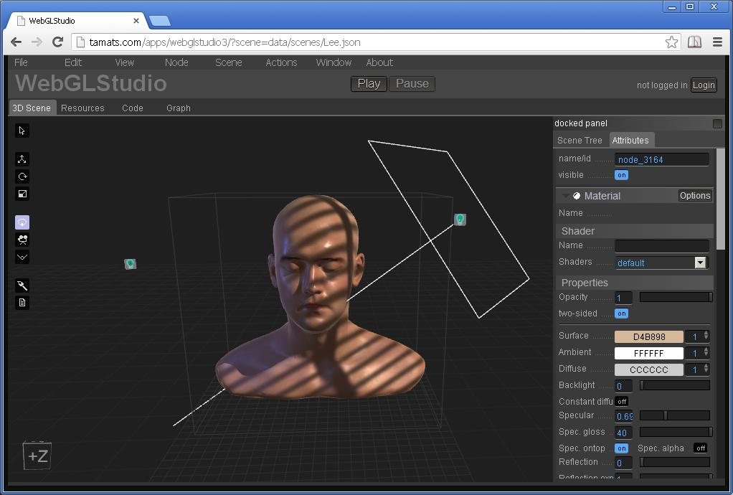
Notes:
Here you can see the interface, in the left side we have the tools and in the right side all the properties of the selected node of the scene.

Slide 14
Resources Manager
Sync'd with the server
Allow to easily upload any kind of asset
Textures
Meshes
Materials
Scenes
Prefabs
Generates a preview image to easy browsing
Allows to add comments or other info
Notes:
One of the main issues when working with 3D on the web is that assets cannot be stored on the user computer due to security reasons, so all the resources have to be on the server. This is achieved with a server layer that handles the storage and adds some useful actions like version control, comments, metadata, etc. The server doesnt need to know the type of file so we can store any kind of assets, even scripts.
Every assets have some useful metadata (author, time of creation, etc) plus a preview image to help during browsing.

Slide 15
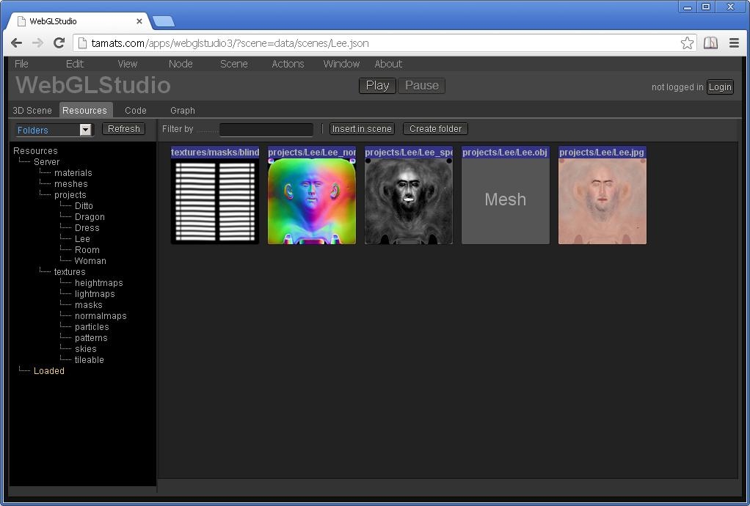
Resources Manager
Notes:
The folder structure on the left represents the folders on the server. And just by draging the files you can store them or move them from one folder to another.

Slide 16
Post-processing FX
Some basic post-processing effects using Color and Depth information
Color curves
Depth of Field
Edges
Lens distortion
Notes:
Other interesting features we have been testing are how some common high-quality rendering technics could be included in our web editor. For instance Postprocessing effects, even the ones using scene information, like the depth.

Slide 17
Particle Engine
Particle emisor with several configurable settings:
Alpha and size curves to control over time
Animated textures
Plane, Sphere and Mesh emisors
Notes:
Also we wanted to explore more CPU intensive areas of the rendering, like particle engines, where the work is split between the CPU and the GPU.
We wanted to have a complex particle system, that allows to create interesting scenarios, and for that you need to support animated textures, curves for properties over time, basic phisics, etc.

Slide 18
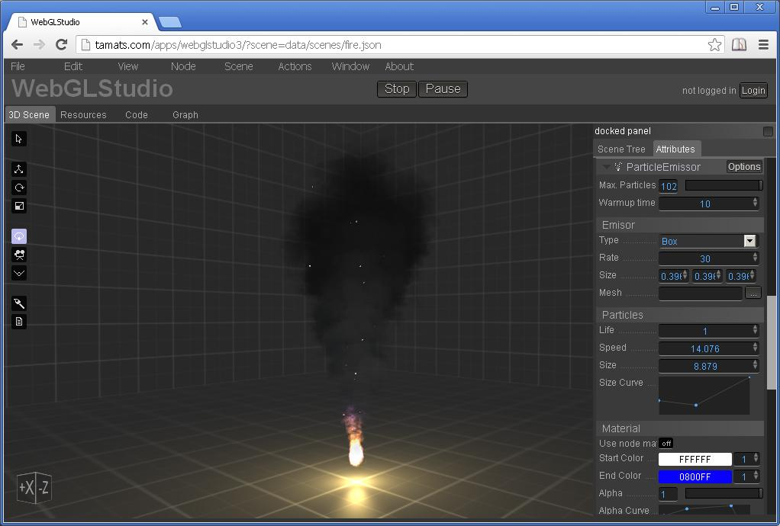
Particles
Notes:
This is an advanced scenary that we thought wouldnt perform adequately on the brower, due to the CPU intensive nature of the app, however the performance is very good thanks to the power of latest Javascript engines. The mesh have to be updated every frame and despite of that, the framerate is very good.

Slide 19
Realtime mesh painting
Allows to paint any channel of a material directly on the browser
Octree to test collision
Paints pixel around the area of collision using an unwrap of the mesh.
Notes:
We also wanted to test if it would be possible to edit the assets somehow, so our first idea was to create a 3D painting tool. Our algorithm uses an Octree to compute the cursor collision with the mesh, and using the UVs as vertex positions computes the distance of every texel of the texture with the point of collision, allowing to do very precisse strokes over the mesh.

Slide 20
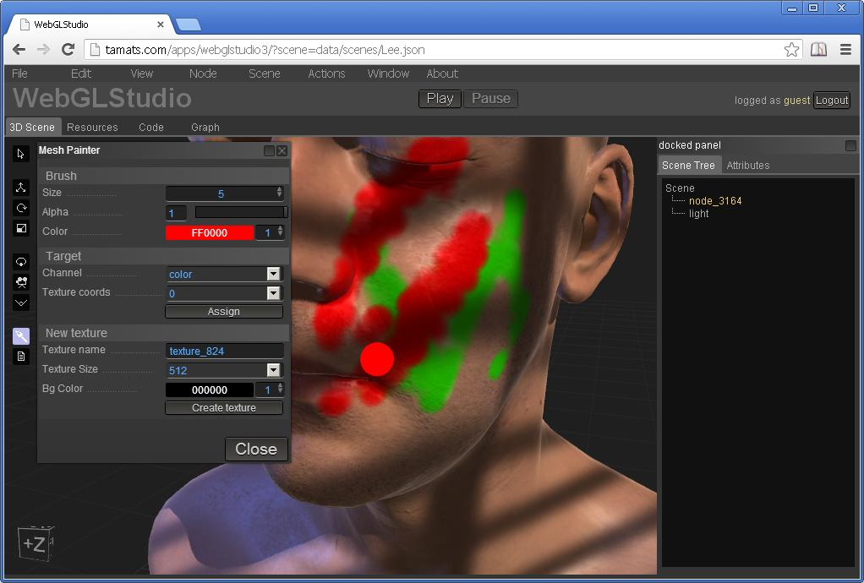
Mesh Painter
Notes:
And you are not limited to paint on the color channel, you can also paint on any other layer (opacity, specular, reflectivity, ...)

Slide 21
Performance
We achieve 60fps in scenes with several lights and meshes using mid-specs computers.
The performance drops when having tens of meshes if the shader is too complex but we are very happy with the results.

Slide 22
Conclusions
WebGL + aspects of Javascripts = very suitable match for creating a 3D Editor
"Democratization" of 3D technology - give 'non-technical' users the ability to create interactive 3D scenes that can be distributed for the web
Open source ASAP...

Slide 23
Thanks!

